Slide 1
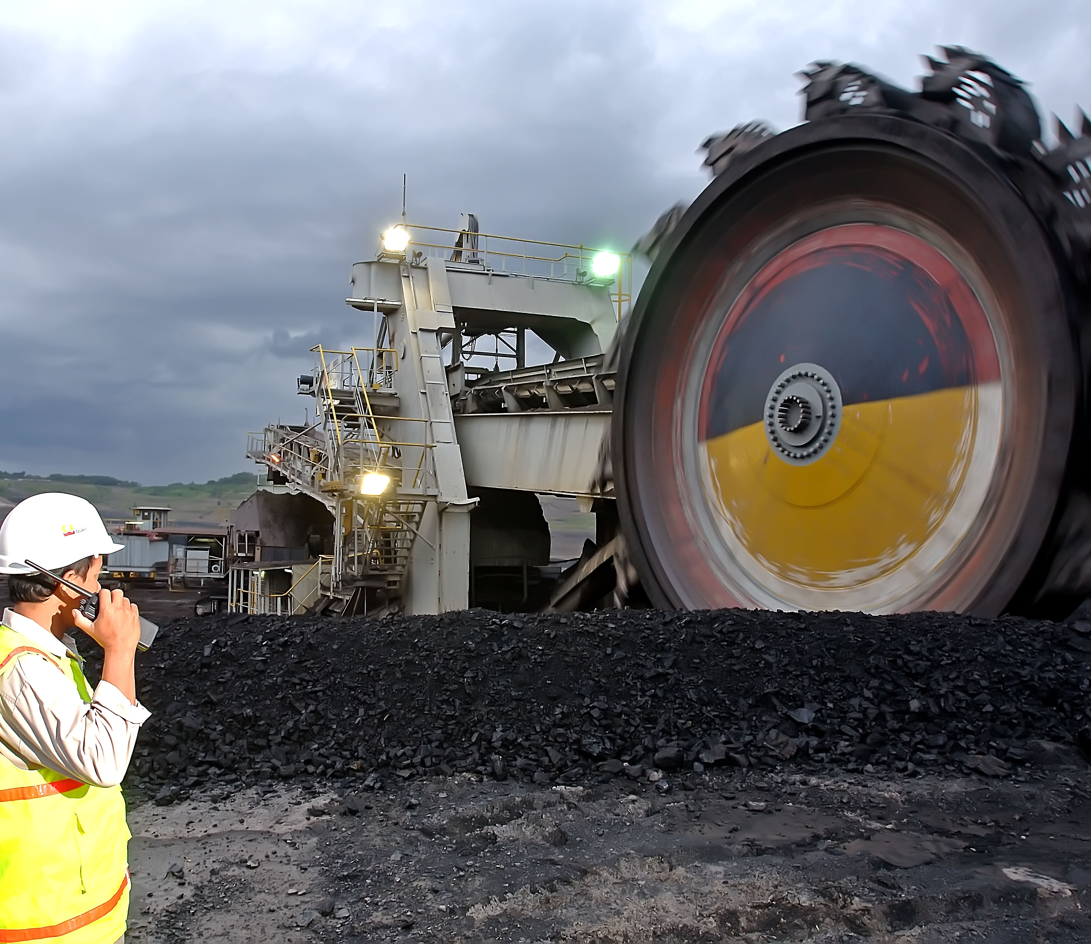


Applied of Machine Learning to predict Coal production
Coal Production in PT. Bukit Asam

Slide 2
Parameter
Demand
Production & Inventory
Transportation
Port Processing
Net Income
Customer Name
Volume
Kualitas Batubara yang dipesan
Lokasi kirim/Penerimaan
Order & Receive Time
Price
Penjualan di Tanjung Enim:
PLTU BA, PTSB, BPI
FOT
Incoterm (in Port):
CIF
CFR
FOB
Lainnya
Stock Based on Quality
Stock in Temporary Stockpile
Stock in Stockpile
Stock in Port Stockpile
Stock in TLS
Stock in Moving Train
Stock in Port Train Station
Production
Production Volume Capacity Per Area
Production Quality
Max Capacity of BWE (Bucket-wheel excavator)
Max Conveyor Capacity
Max Coal Mill
Max Stockpile Capacity
Cost of Production
Transport Volume
Max TLS Capacity
Max Train Load Capacity
Real Transport Volume
Jenis Transportasi
Biaya Transportasi
Waktu Transport
Coal Volume Received
Coal Received Quality
Transport from Port to Mother Vessel
Max Port Stockpile
Max Port Conveyor
Max Kapal Tongkang
Vessel Transport Cost
Stock Opname Cost
Other Cost & Income:
Demurrage
Detention
Despatch
Volume Coal Sales
Coals Quality
Price
COGS
Available for Production
Available for Transportation
Available for Transportation
Market Brand (1)
Truck
Tanjung Enim
Demand
Produksi
Eksport
Mine Brand
TLS
Port
Market Brand (2)
Domestik

Slide 3
Coal Production Parameter
Man
Machine
Material
Jumlah Tenaga Kerja
Skill/Tingkatan Tenaga Kerja
K3
Jenis Alat/ Mesin yang digunakan
Jumlah alat yang digunakan
Temporary Stockpile
Conveyor
Stockpile
TLS
Moving Train
Port Capacity
Product Name Batubara
Kalori batubara
Jumlah cadangan batubara
Coal
Production
Data Stockpile
Data Rehandling
Jarak Angkut
Target Produksi
Target Penjualan
Holiday Season
Curah Hujan
Issue Social Masyarakat
Target Keuangan
Target Revenue
Target Net Income
Data
Kurs Harian/Bulanan
Harga Batubara ICI dan GCI
Method
Environment
Money

Slide 4
How to get Presprective?
Kapasitas Produksi
Tidak Terpenuhi
Stock
Volume Produksi
Jenis Batubara
Waktu
Jarak
Menambah Kapasitas Produksi
Demand
Permintaan Pasar
Volume
Jenis (Kualitas
Incoterms:
CIF (Cost, Insurance, Freight)
FOB (Free on Board)
Lainnya
Waktu Order dan Waktu Terima
Terpenuhi
Harga
Hasil Produksi Net
Revenue
COGS
Income:
Revenue-COGS

Slide 5

Process Flow of Forecasting Algorithm
Step. 1 Data Preprocessing
Define Columns :
Columns selections usage (tanggal, jenis, tipe, product_type_name, loc_src_area_name, contractor_name, loc_dest_area_name, tonase)
RAW dataset :
*from query SQL table
(DM_Mine
Preprocessing:
- Chose
Cleansing dataset based on outliers and remove null coal production
Feature Engineering:
Sum all coal production and striping based on daily date
Split loc_src_area data one-by one:
Perform data splitting based on loc_src_area_name, or contractor_name
Step. 2 Machine Learning Model
Machine Learning Model Evaluation for Test Dataset:
sMAPE
Hyperparameter Tuning:
Layer Optimization
Learning Rate adjustment
Loss function optimization
Deep Learning Modelling:
Prophet Forecasting
Training Dataset:
90% complete dataset
Complete Dataset:
Outlier free dataset
Split loc_src_area_name, for production and SR.
Split contractor name for
Group by in every date
Domain Expert Analysis:
Prediction Reliability
Evaluation
Deploying Model:
Deploy high performance model to the RAW Data
Test Dataset:
10% of complete dataset
Step. 3 The Deployment
Legend :
Preprocessing
Training Dataset
Deploy on the Tableau
Test Dataset
Deploy to Datamart :
Ingest prediction result into datamart
Dashboard Deployment :
Visualization on Tableau
Model update :
Deep Learning model updated every time adjusted
Forecasting Coal Production Daily in PT. Bukit Asam

Slide 6






Slide 7
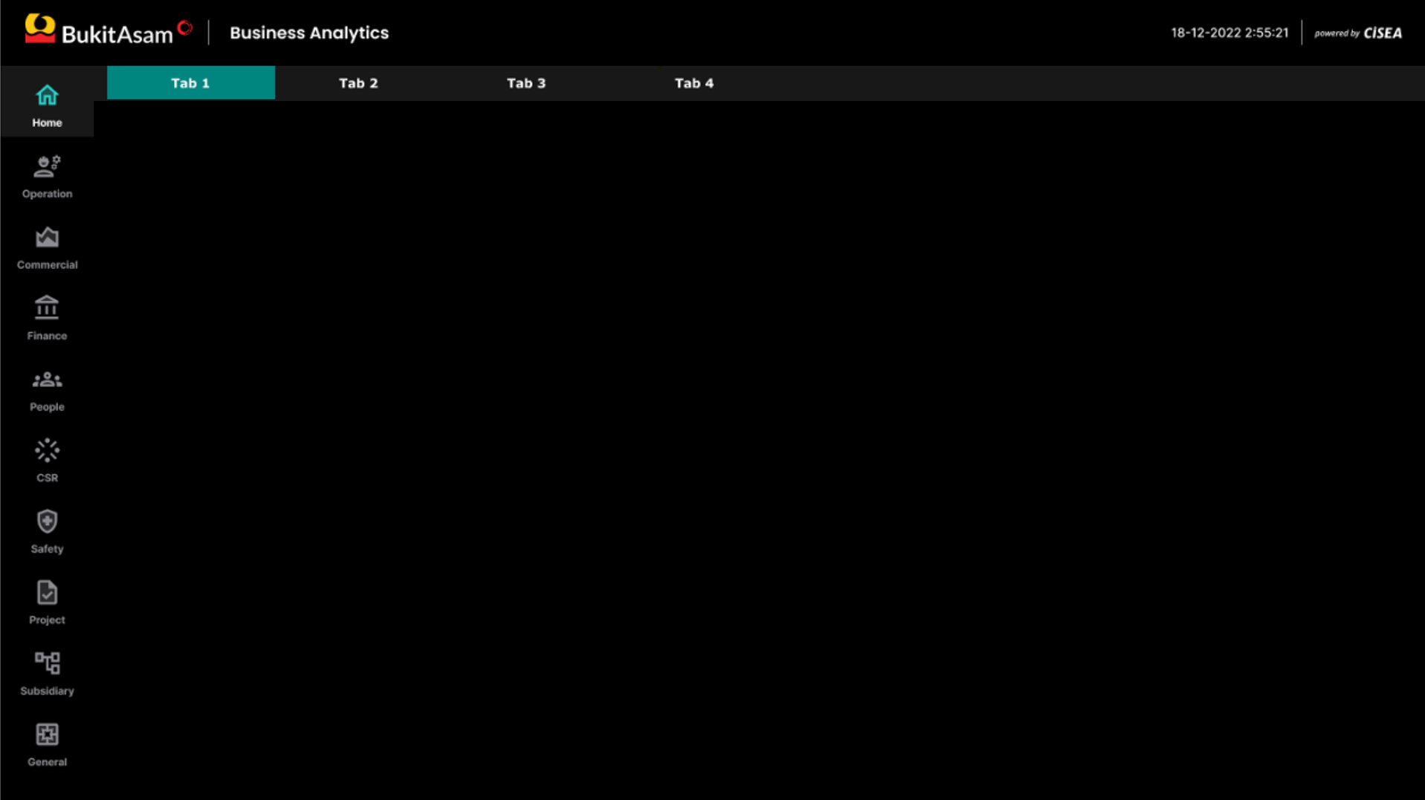
Mockup Version 1
Last Update: 21 February 2023
Peiiode
MoM
Bulan
January
Tahun
2023
Banko Tengah
9.999.999 Ton
99,99% MoM
Banko Barat
9.999.999 Ton
99,99% MoM
Production
Input Parameter
99.999.999 Ton
105,99% MoM
MTB
9.999.999 Ton
99,99% MoM
Parameter 1
999.999.999.999
TAL
9.999.999 Ton
99,99% MoM
Parameter 2
999.999.999.999
Parameter 3
999.999.999.999
Real
RKAP
Rakor
For
Parameter 4
999.999.999.999
Product Name
Parameter 5
999.999.999.999
Area | Kalori
 | 41 | 43 | 45 | 47 | 49 | 51 | 53 | 55 | 57 | 59 | 61 | 63 | 65 | 67 | 69 | 71
Banko Barat | 0,46 | 0,62 | 0,89 | 0,13 | 0,83 | 0,29 | 0,06 | 0,01 | 0,67 | 0,85 | 0,00 | 0,14 | 0,77 | 0,79 | 0,07 | 0,12
Banko Tengah | 0,90 | 0,52 | 0,15 | 0,61 | 0,61 | 0,45 | 0,47 | 0,26 | 0,11 | 0,12 | 0,38 | 0,66 | 0,68 | 0,17 | 0,95 | 0,11
MTB | 0,50 | 0,80 | 0,49 | 0,06 | 0,63 | 0,70 | 0,71 | 0,50 | 0,06 | 0,17 | 0,34 | 0,26 | 0,50 | 0,79 | 0,92 | 0,66
TAL | 0,67 | 0,69 | 0,26 | 0,24 | 0,74 | 0,95 | 0,73 | 0,41 | 0,92 | 0,34 | 0,01 | 0,67 | 0,91 | 0,30 | 0,18 | 0,71
Parameter 6
999.999.999.999
Parameter 7
999.999.999.999
Parameter 8
999.999.999.999
Parameter 9
999.999.999.999
Parameter 10
999.999.999.999
Parameter 11
999.999.999.999
Parameter 12
999.999.999.999
Parameter 13
999.999.999.999
Parameter 14
999.999.999.999
Parameter 15
999.999.999.999
Parameter 16
999.999.999.999

Slide 8
Mockup Version 2
Last Update: 31 February 2023
Periode
MoM
Bulan
January
Tahun
2023
Banko Tengah
9.999.999 Ton
99,99% MoM
Banko Barat
9.999.999 Ton
99,99% MoM
Production
99.999.999 Ton
105,99% MoM
MTB
9.999.999 Ton
99,99% MoM
TAL
9.999.999 Ton
99,99% MoM
RKAP
Rakor
Real
For
Product Name
Area | Kalori
 | 41 | 43 | 45 | 47 | 49 | 51 | 53 | 55 | 57 | 59 | 61 | 63 | 65 | 67 | 69 | 71
Banko Barat | 0,46 | 0,62 | 0,89 | 0,13 | 0,83 | 0,29 | 0,06 | 0,01 | 0,67 | 0,85 | 0,00 | 0,14 | 0,77 | 0,79 | 0,07 | 0,12
Banko Tengah | 0,90 | 0,52 | 0,15 | 0,61 | 0,61 | 0,45 | 0,47 | 0,26 | 0,11 | 0,12 | 0,38 | 0,66 | 0,68 | 0,17 | 0,95 | 0,11
MTB | 0,50 | 0,80 | 0,49 | 0,06 | 0,63 | 0,70 | 0,71 | 0,50 | 0,06 | 0,17 | 0,34 | 0,26 | 0,50 | 0,79 | 0,92 | 0,66
TAL | 0,67 | 0,69 | 0,26 | 0,24 | 0,74 | 0,95 | 0,73 | 0,41 | 0,92 | 0,34 | 0,01 | 0,67 | 0,91 | 0,30 | 0,18 | 0,71

Slide 9
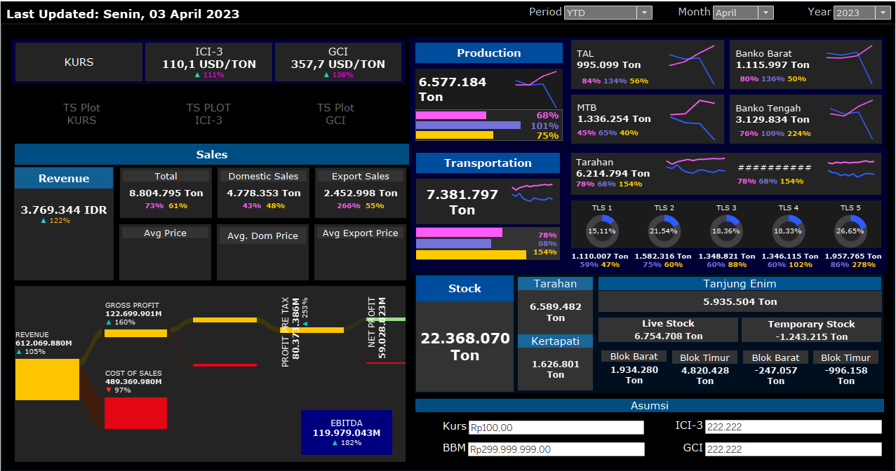
Dashboard Mockup Version 3,

Slide 10
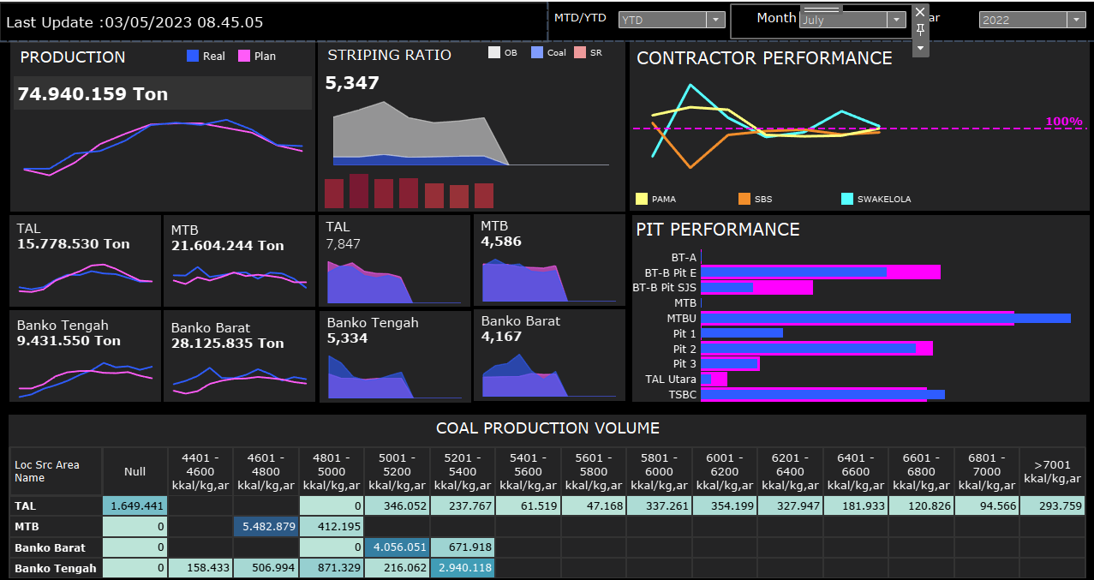
Dashboard Mockup Version 4, Focus on Production Data

Slide 11
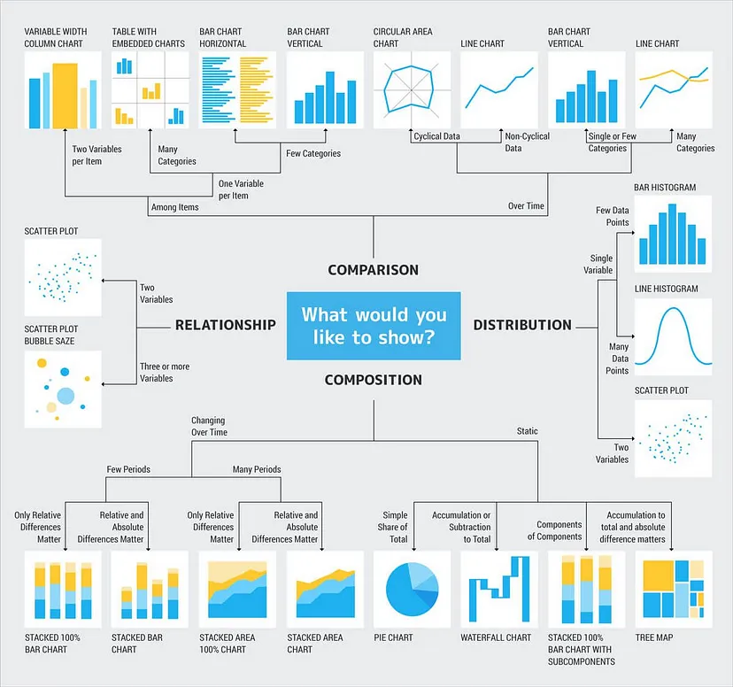
Type of Chart

